Slide 1

ADVANCED ALGORITHMS

Slide 2

ADVANCED ALGORITHMS
BASICS OF COMPLEXITY

Slide 3
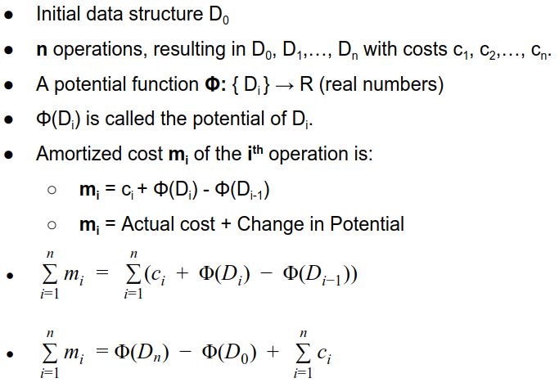
ADVANCED ALGORITHMS
BASICS OF COMPLEXITY

Slide 4
ADVANCED ALGORITHMS
BASICS OF COMPLEXITY
Amortized Analysis: Potential Method
If Φ(D_{n}) ≥ Φ(D₀), then total amortized cost is an upper bound of total actual cost.
Φ(D_{i}) ≥ Φ(D₀) is required for any i.
It is convenient to make Φ(D₀) = 0, and Φ(D_{i}) ≥ 0, for all i to satisfy Φ(D_{i}) ≥ Φ(D₀).
If the potential change is positive (i.e., Φ(D_{i}) - Φ(D_{i-1}) > 0), then m_{i} is an overcharge.
If the potential change is negative, then m_{i} is an undercharge (discharge the potential to pay the actual cost).

Slide 5
ADVANCED ALGORITHMS
BASICS OF COMPLEXITY
Dynamic Table
Scenario
A table is essentially just an array
Required Table Size not known in advance
Table Size changes dynamically
Size increases with insertion and decreases with deletion
Reallocation requires copying all objects stored in the original table over into the new table.
Operations on Dynamic Table
Insertion and Deletion

Slide 6
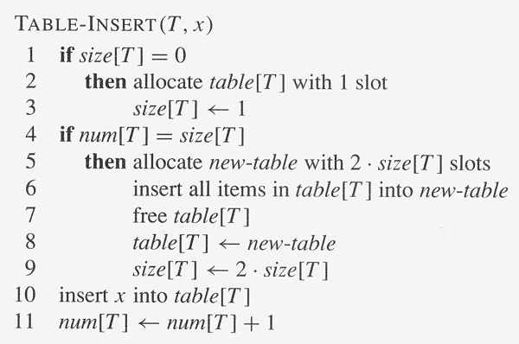
ADVANCED ALGORITHMS
BASICS OF COMPLEXITY
Dynamic Table

Slide 7
ADVANCED ALGORITHMS
BASICS OF COMPLEXITY
Dynamic Table
1
1 | 2 | 3
1 | 2 | 3 | 4
1 | 2
1 | 2 | 3 | 4
1
1 | 2 | 3
1 | 2
1 | 2 | 3 | 4 | 5 | 6 | 7 | 8

Slide 8
ADVANCED ALGORITHMS
BASICS OF COMPLEXITY
Dynamic Table
1 | 2 | 3
1 | 2
Insertion of 3 does not cause table doubling hence time complexity is O(1)
1 | 2 | 3 | 4
O(n)
1 | 2 | 3 | 4
Worst case complexity is O(n²) which is not tight upper bound

Slide 9
ADVANCED ALGORITHMS
BASICS OF COMPLEXITY
Dynamic Table
5
9
17
33
Happens half as often but does twice the work
= 1
Item no | 1 | 2 | 3 | 4 | 5 | 6 | 7 | 8 | 9 | 10 | 11 | 12 | 13 | 14 | 15 | 16
operations | 1 | 1 | 3 | 1 | 5 | 1 | 1 | 1 | 9 | 1 | 1 | 1 | 1 | 1 | 1 | 1
Item no | 17 | 18 | 19 | 20 | 21 | 22 | 23 | 24 | 25 | 26 | 27 | 28 | 29 | 30 | 31 | 32
operations | 17 | 1 | 1 | 1 | 1 | 1 | 1 | 1 | 1 | 1 | 1 | 1 | 1 | 1 | 1 | 1
Item no | 33
operations | 33

Slide 10
ADVANCED ALGORITHMS
BASICS OF COMPLEXITY
Analyzing Time Complexity
Item no | 1 | 2 | 3 | 4 | 5 | 6 | 7 | 8 | 9 | 10 | 11 | 12 | 13 | 14 | 15 | 16
operations | 1 | 1 | 3 | 1 | 5 | 1 | 1 | 1 | 9 | 1 | 1 | 1 | 1 | 1 | 1 | 1
Item no | 17 | 18 | 19 | 20 | 21 | 22 | 23 | 24 | 25 | 26 | 27 | 28 | 29 | 30 | 31 | 32
operations | 17 | 1 | 1 | 1 | 1 | 1 | 1 | 1 | 1 | 1 | 1 | 1 | 1 | 1 | 1 | 1
1. Aggregate Method
Time Complexity of one operation = (Total cost of expensive operations)/n
= 1 + 3 + 5…….=66/33 which is twice the number of insertions(33).
Total cost of expensive operations = 2n = O(n)
Amortized Time = O(n)/n = O(1)
Total cost of expensive and cheap operations < 3n = O(n)
Amortized Time = O(n)/n = O(1)

Slide 11
ADVANCED ALGORITHMS
BASICS OF COMPLEXITY
1. Aggregate Method
cost of i^{th} operation is
c_{i}= i if i-1 is an exact power of 2
1 otherwise
∑c_{i} <= n + ∑ 2^{i}
<= n+ 2n = 3n hence O(n)
n
log n
i=1
i=0

Slide 12
ADVANCED ALGORITHMS
BASICS OF COMPLEXITY
2. Accounting Method
Assign every operation a cost.
Any Surplus goes into the bank.
Idea: Need to overcharge simpler operations
Build up the saving to afford expensive operations later
Balance should always be greater or equal to Zero.
For the Dynamic Array
Charge ₹3 for insertion of i^{th} item.
₹1 pays for the item’s insertion.
₹1 pays for the item to be moved in the future.
₹1 pays for an item in the lower half to be moved.

Slide 13
ADVANCED ALGORITHMS
BASICS OF COMPLEXITY
Accounting Method
2 | 2 | 2 | 2
1 | 1 | 1 | 1
₹4
1 | 2 | 3 | 4
₹0
1 | 2 | 3 | 4
₹8
1 | 1 | 1 | 1 | 2 | 2 | 2 | 2
₹12
1 | 2 | 3 | 4 | 5 | 6 | 7 | 8

Slide 14
ADVANCED ALGORITHMS
BASICS OF COMPLEXITY
Accounting Method
1 | 1 | 1 | 1 | 1 | 1 | 1 | 1
₹8
 |  |  |  | 5 | 6 | 7 | 8
1 | 1 | 1 | 1 | 0 | 0 | 0 | 0
₹4
1 | 2 | 3 | 4 | 5 | 6 | 7 | 8
1 | 1 | 1 | 1 | 0 | 0 | 0 | 0 | 2 | 2 | 2 | 2 | 2 | 2 | 2 | 2
₹20
1 | 2 | 3 | 4 | 5 | 6 | 7 | 8 | 9 | 10 | 11 | 12 | 13 | 14 | 15 | 16
Since cost of each operation is ₹3
Amortized Time = O(1) a constant

